Slide 1
F# Units of Measure
(and an alternate approach…)

Slide 2
Background and Motivation
Computation with physical quantities must be done with consistent units! Otherwise, there can be serious consequences. A famous example is NASA’s loss of a Mars orbiter due to inconsistent use of units.
If all quantities are (only) represented as floating point numbers, the compiler doesn’t know, for example, that this incarnation of Bernoulli’s equation, let qz = 0.00256 * V**2 only has valid meaning as a wind pressure in Lb_{f}/ft² if the numerical value provided for V is in mph!
Various solutions have been proposed and committees convened to develop implementations for different languages. Also, many libraries have been developed (e.g., C++ has Boost.Units)
My interest started when I was programming in C++. In Scientific and Engineering C++ by Barton and Nackman, a solution is presented that uses C++ templates.
Several years ago, I implemented a solution in C#.

Slide 3
Some Definitions (from Wikipedia)
A physical quantity (or "physical magnitude") is a physical property of a phenomenon, body, or substance, that can be quantified by measurement.
By convention, physical quantities are organized in a dimensional system built upon base quantities, each of which is regarded as having its own dimension.
The most well known system is the International System of Units (SI). There are many others: (e.g., US Customary Units, Imperial Units)
SI defines seven fundamental physical quantities – Length, Time, Mass, Temperature, Electrical Current, Amount of Substance, and Luminous Intensity.
Each of these quantities has a corresponding fundamental unit – meter, second, kilogram, kelvin, ampere, mol, candela
Derived quantities are defined in terms of the fundamental quantities and can also have corresponding units.

Slide 4
F#’s Approach
F#’s Units of Measure implementation extends the language’s type system and is based on Andrew Kennedy’s Ph.D. research. Andrew works for Microsoft Research, Cambridge
F#’s implementation doesn’t make any assumptions about the “system” of units you are using. It allows/requires you to create your own system!
F# doesn’t really know or care about a quantity’s dimensionality, only its units. They’re essentially regarded as the same thing as there is no distinction. Each unique atomic unit name behaves like a dimension.
F# automatically infers and assigns NEW unit types when expressions with existing unit types are composed according to specific algebraic rules that most 7th graders understand (rules of Abelian Groups for the Math Geeks).
Unit types are used for confirming type usage consistency at compile time. They are completely erased in the executable code; therefore, no performance implication!

Slide 5
Unit of Measure Definition Syntax
[<Measure>] type unit-name [ = measure ]
measure → unit-name | 1 // dimensionless, usually used to invert (1/m) | measure ‘*’ measure | measure ‘/’ measure | measure ‘^’ integer // integer can be negative | measure ‘⌴‘ measure // here, right measure can’t be in parens | ‘(‘ measure ‘)’
[<Measure>] type kg
[<Measure>] type N = kg m / s^2
[<Measure>] type Nm = m * kg / s s * m
[<Measure>] type Nm2 = N m
[<Measure>] type Hz = 1 / s
The expression for measure is normalized using standard algebraic rules for product, quotient, and exponent simplifications.
unit-names with positive and negative exponents are grouped separately (numerator, denominator),
unit-names are ordered alphabetically in the numerator and denominator.
When previously defined unit-names are used, they are NOT expanded into their definitions (for display purposes); however, type consistency checking still works correctly as if they were.
‘ ‘ (space) and ‘*’ both combine (multiply) units, but have slightly different semantics when they appear in an expression following ‘/’. Also, space must only combine names (possibly raised to integer powers), not more complex or parenthesized expressions.
Even though it’s defined using the ‘type’ keyword, a unit of measure isn’t completely a type, yet...
Notes:
Show examples in FSI

Slide 6
Value Creation Syntax
Values actually can’t be instantiated with units of measure types defined as shown on the previous slide. The unit of measure has to be combined with a numeric type. Values can be created by juxtaposing a numeric literal with a unit expression enclosed in angle brackets. There can’t be any space between them. The resulting value’s type is the composite of the numeric type and the unit of measure.
let x = 5.0<N> // x has type float<N>
let y = 6.5<N/m> // y has type float<N/m>
let z = x * y // z has new inferred type: float<N^2/m>
let w = x + y // ERROR!! x and y must have (or be reducible to) the // same units

Slide 7
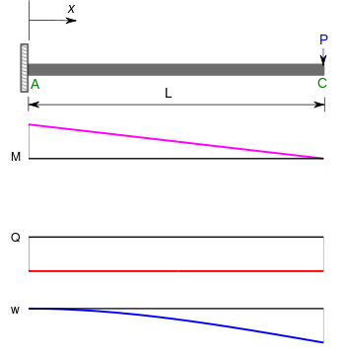
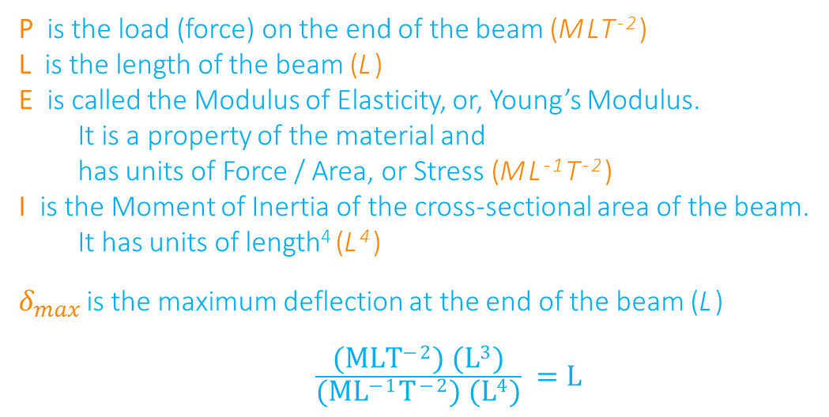

Example – Cantilever Beam
$$δ_{max}=\frac{P L^{3}}{3 E I}$$
P is the load (force) on the end of the beam (MLT⁻²)
L is the length of the beam (L)
E is called the Modulus of Elasticity, or, Young’s Modulus.
It is a property of the material and has units of Force / Area, or Stress (ML⁻¹T⁻²)
I is the Moment of Inertia of the cross-sectional area of the beam.
It has units of length⁴ (L⁴)
$δ_{max}$ is the maximum deflection at the end of the beam (L)
$\frac{\text{(}\text{MLT}\text{−2}\text{) (}\text{L}\text{3}\text{)}}{\text{(}\text{ML}\text{−1}\text{T}\text{−2}\text{) (}\text{L}\text{4}\text{)}} =\text{L}$

Slide 8
Alternate Approach
Advantages over F# Approach
Disadvantages vs. F# Approach
Based on Dimensions instead of Units.
Allows quantities of consistent dimensionality to be added and subtracted, even if they are defined with different units (e.g., feet and meters).
Conversion between dimensionally consistent units is very easy. Creation of scaled units is easy. F# requires explicit conversion functions.
Can be implemented and/or used in other languages.
Consistency checks have to be made at runtime - slower.
Dimensional information has to be stored in the value - more memory required (about double)
F# completely removes the unit information from the runtime code, so no space or time penalty.
Intellisense only knows about “Quantity”

Slide 9
Resources
Andrew Kennedy’s Blog http://research.microsoft.com/en-us/um/people/akenn/units/
MSDN Units of Measure page http://msdn.microsoft.com/en-us/library/dd233243.aspx
F# Specification Document – Chapter 9 http://research.microsoft.com/en-us/um/cambridge/projects/fsharp/manual/spec.pdf
BOOST Units Documentation http://www.boost.org/doc/libs/1_55_0/doc/html/boost_units.html
Wikipedia Articles – International System of Units, Physical Quantities http://en.wikipedia.org/wiki/International_System_of_Units http://en.wikipedia.org/wiki/Physical_quantity

